Slide 1
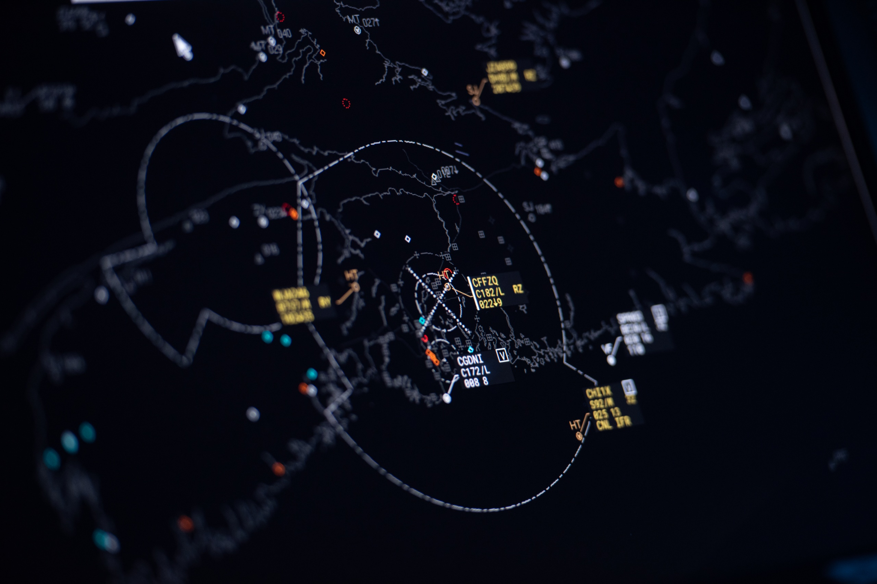
The Air Traffic Control System
Safety uber alles

Slide 2
What we’ll talk about
What is the Air Traffic Control system (ATC) and what is its purpose
Civilian vs military
Flight phases - Handovers Between Controllers
Ground Systems
Sensor types
Cooperative (IFF modes, ADSB)
Non-cooperative: active radar
Passive: MLAT https://map.adsbexchange.com/mlat-map/
Sensor to Controller data flow (track creation) From plot to track
Protocols (asterix, beast, radarcape, military protocols)
On-board systems
How does an aircraft know its position?
How does an aircraft communicate?
Demo:
ADS-B
MLAT
The Future
SESAR “bye-bye corridors”
Black box in the cloud “so that others can learn”
Remote control towers

Slide 3
What is ATC?
The Air Traffic Control is a service provided by air traffic controllers who guide aircraft within a controlled airspace and provide information and support.
The purpose of the ATC is efficient and sage flight operations.

Slide 4
Civilian vs military ATC/C2
Civilian ATC
Manages the movement of commercial, private and general aviation aircraft in the airspace over a country or region.
It is typically managed by government agencies.
Military ATC/Command and Control (C2)
Manages the movement of military aircraft, including fighter jets, transport planes, and helicopters but also Surface to Air Missile systems against air targets during peace, crisis and war
Managed by the military branches of a country's government
It also provides air traffic control services to civilian aircraft in times of emergency or crisis
Military ATC operations are often classified and involve sensitive information
Provides flight information to military aircraft flying outside assigned areas and close control of military aircraft inside assigned areas
Notes:
Q: To GCI είν’ sub-mode του Military; Ή ειν’ δύο διαφορετικοί τρόποι λειτουργίας;

Slide 5
Flight phases - Handovers Between Controllers
There are 3 types of controllers for a flight from gate to gate:
Tower Controller is a person that provides air traffic control service at and in the vicinity of an aerodrome.
Approach Controller is a person that provides air traffic control for departing and arriving flights. They are the link between the tower controllers and the area controllers.
Area Controller (sometimes called en-route controller) is a person that normally serves the flights during the cruise phase.

Slide 6
Ground systems

Slide 7
Sensor Types
Cooperative
Secondary Surveillance Radar (SSR) - IFF modes (1, 2, 3A, 3C, 4, 5, S)
Automatic Dependent Surveillance–Broadcast (ADS-B)
Airborne Collision Avoidance System (ACAS)
Non-cooperative
Active
Primary Surveillance Radar (PSR)
Precision Approach Radar (PAR)
Passive (Cooperative and non-cooperative transmitters)
MLAT https://map.adsbexchange.com/mlat-map/
Analog television signals
FM radio signals
Cellular phone base stations
Digital audio broadcasting
Digital video broadcasting
Terrestrial High-definition television transmitters in North America
GPS satellites (GPS reflectometry)

Slide 8
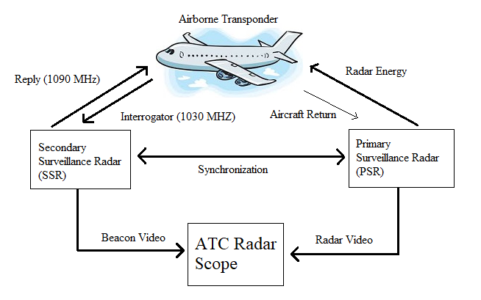
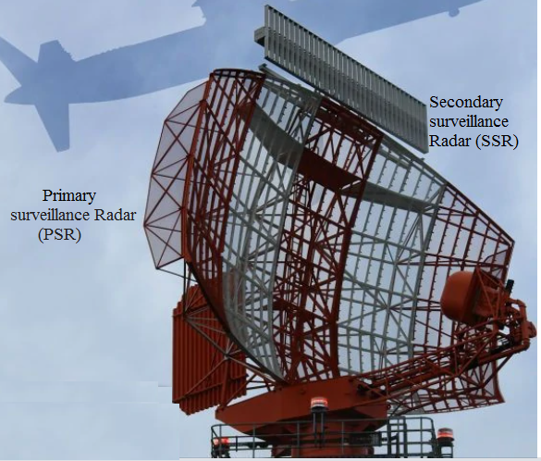
IFF (Identification Friend or Foe)
Aircraft respond to encoded queries sent at 1030/1090MHz by ground stations or other aircraft.
= The “ping” of aviation.
The message typically includes
Mode 3 (four-digit ID set by the crew) and
Mode C (flight altitude)
They can actually be set to send to wrong or misleading replies.
IFF emergency codes:
7500 Hijacking
7600 Loss of communications
7700 General emergency (systems failure etc)
Notes:
Σε μια τυπική μέρα έχεις 2-3 7700 squawk codes πάνω απ’ την Ευρώπη.

Slide 9
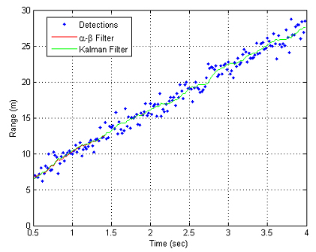
Track creation: From plot to track
Plot. A target report resulting from digital integration of the received echoes (PSR) or replies (SSR) inside the antenna beamwidth. The PSR report contains range, bearing and altitude information whereas the SSR report contains in addition Mode 3/A identity code and the Mode C decoded altimeter height value.
Track. A target report resulting from the correlation, by a special algorithm (tracking) of a succession of radar reported positions for one aircraft. The report normally contains smoothed position and speed vector information.

Slide 10
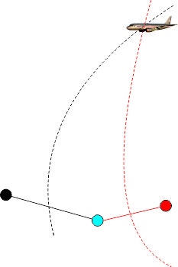
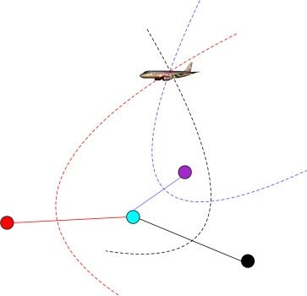
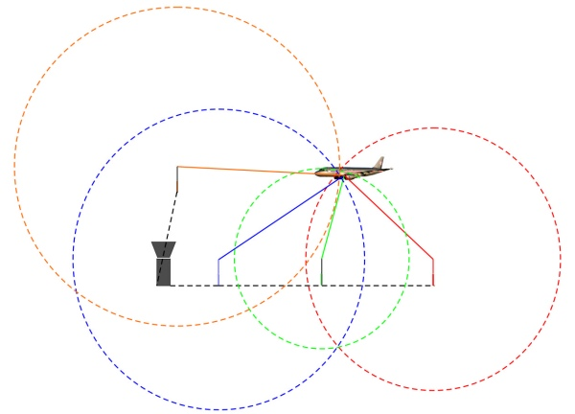
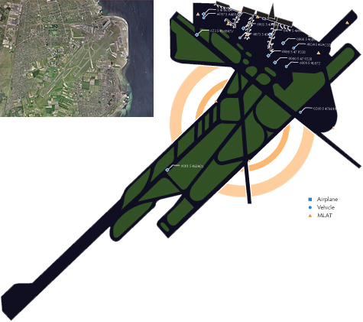
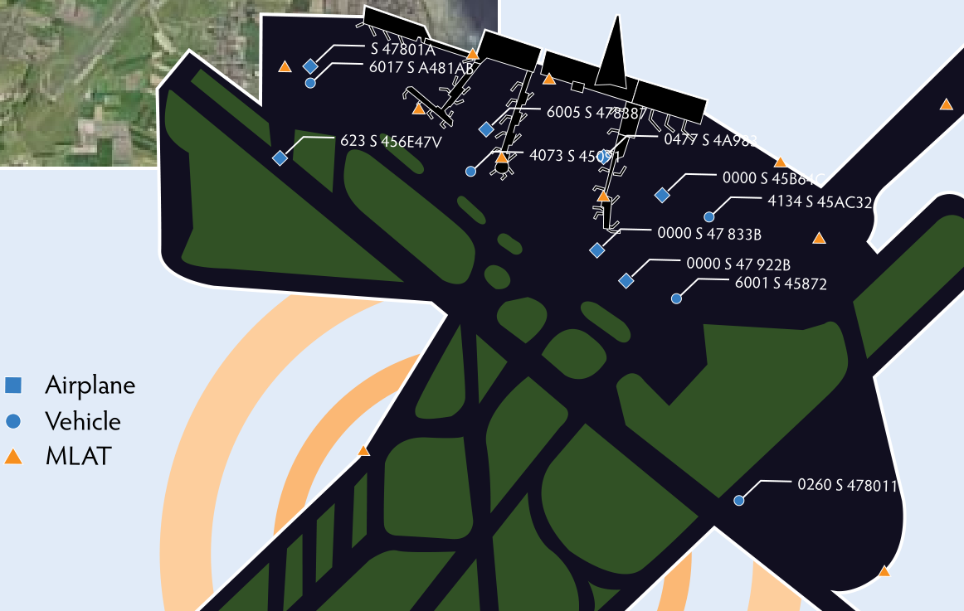
Multilateration (MLAT)
TDOA (time difference of arrival)
time-synchronized receivers
known velocity of electromagnetic waves in the space
response to SSR (mode-S), IFF – friend/foe, ADS-B

Slide 11
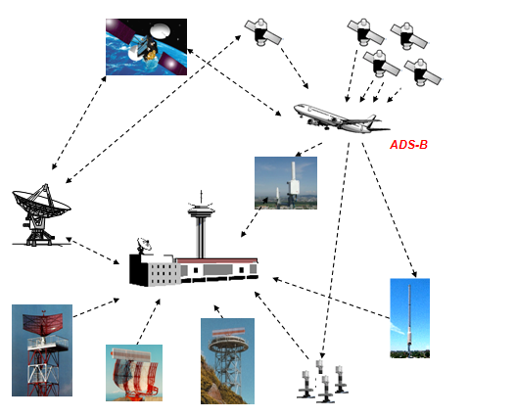
Protocols
Sensor to Controller data flow
From radar to Air Traffic Control Centre (ATCC)
ASTERIX (All Purpose Structured Eurocontrol Surveillance Information Exchange)
Most common categories used: 1, 2, 19, 20, 21, 34, 48, 62
Raw ADS-B
BEAST (produced by dump1090 ADS-B receiver program)
Radarcape (Same as BEAST with more accurate GPS timestamp)
Military Protocols
Many diverse protocols have been historically used.
Nowadays military categories of ASTERIX are used as well as the Civilian ASTERIX categories mentioned above.

Slide 12
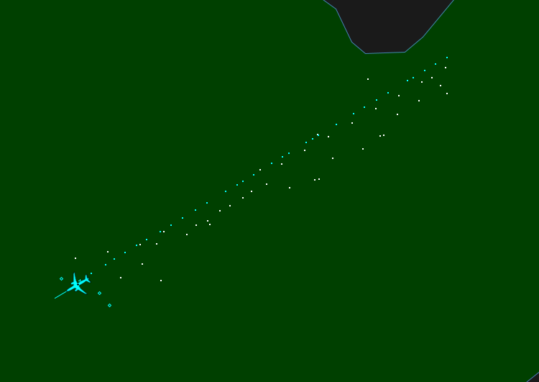
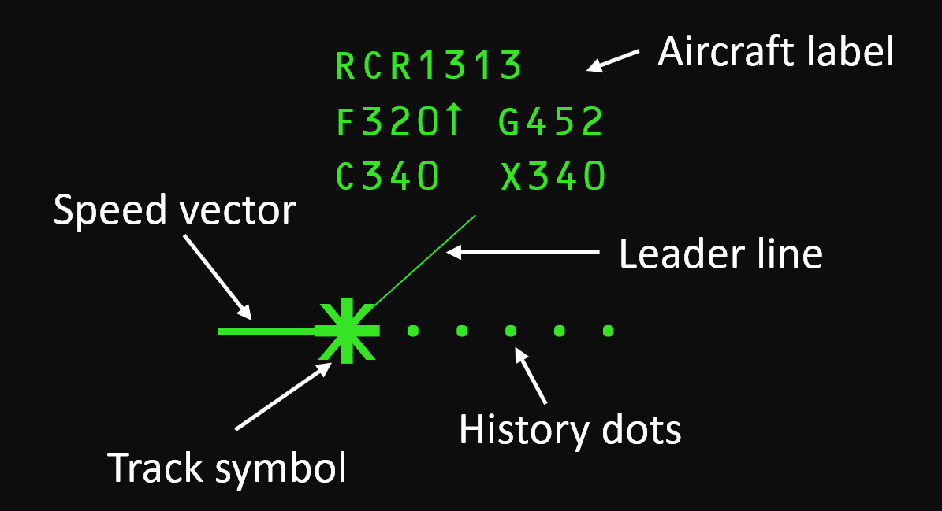
What’s on a radar screen?
MILITARY
CIVILIAN

Slide 13
On board systems

Slide 14
On-board Systems
How do aircraft know their position and communicate?

Slide 15
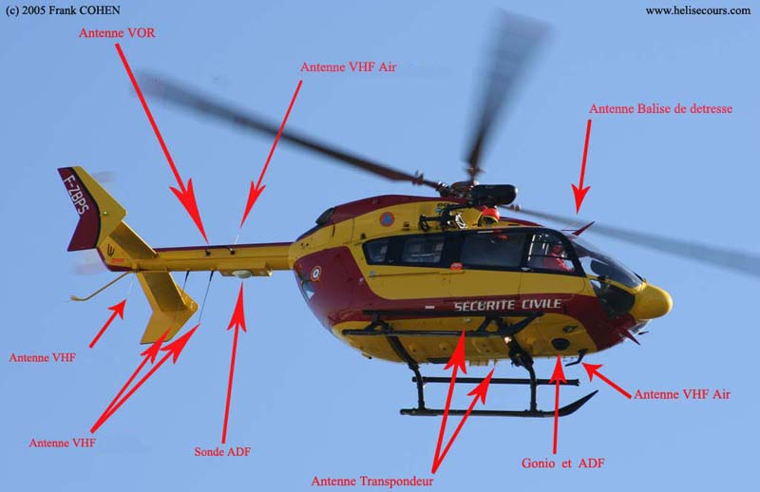

Slide 16
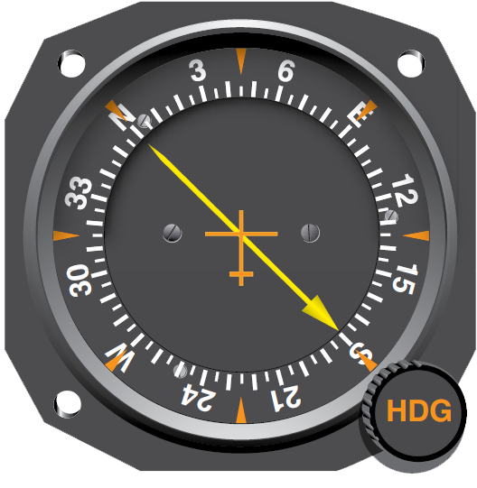
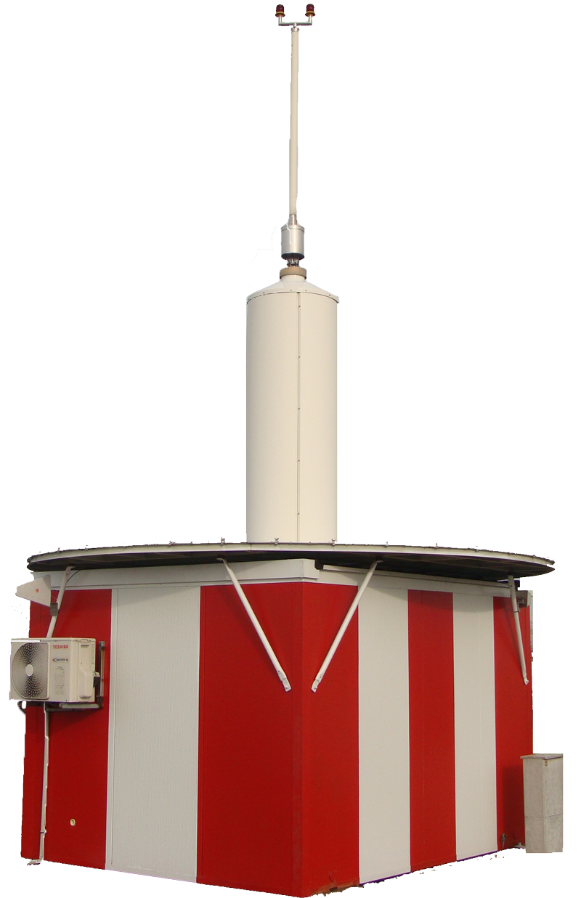
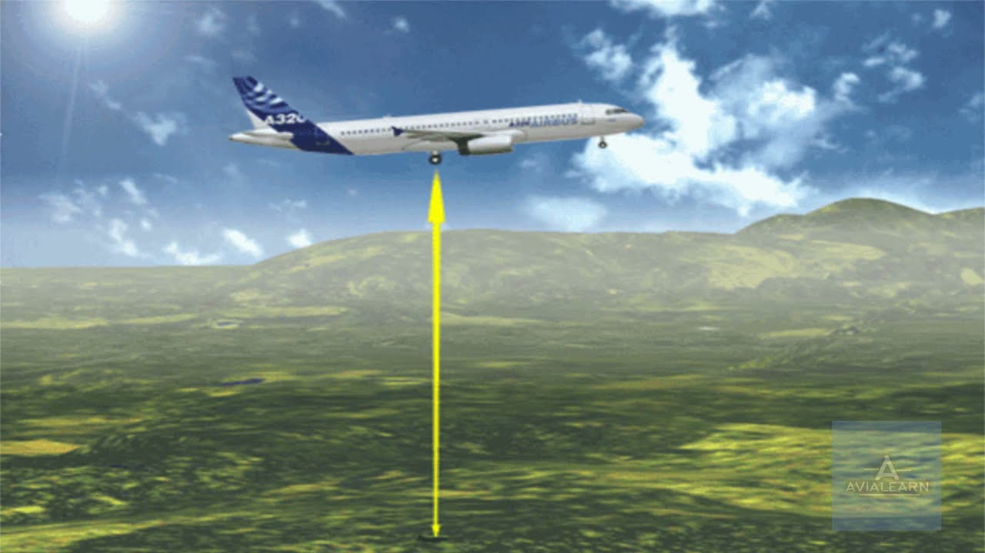
On Board Systems: Navigation
First of all an aircraft needs to know its position in space
Typical navaids in chronological order:
LORAN
DME+VOR=TACAN
Radio altimeter
INS
GPS
ADF

Slide 17
On Board Systems: Voice Comms
The aircraft must then be able to transmit its position to the ATCC and to other aircraft via voice or data links.
2 identical voice radios ACTIVE + STANDBY
VHF/UHF radios transmitting in reserved “Air band”:
Civilian: VHF 108-137 MHz , Guard 121.5MHz
Military: +UHF 225-399 MHz, Guard 243MHz
All aircraft listen also on Guard frequency.
Why ΑΜ modulation?
AM receivers are simpler and more energy efficient
Compatibility with very old radios
Most importantly if two aircraft transmit simultaneously in AM, the stronger/closer will be heard. In FM they’d just jam each other.
With a relatively small transmission power of ~25W they achieve very good reception due to altitude:
at 20 m height (top of a building) a radio has 18 km line of sight
at 10 km flight altitude a radio has 400 km line of sight. Practically area >150.000 km² = a whole EU country

Slide 18
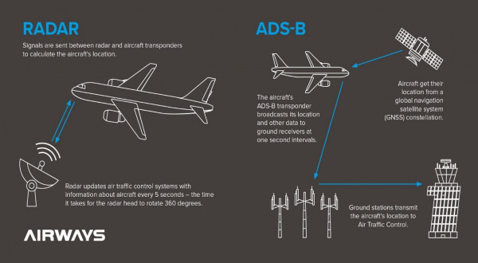
On Board Systems: Data Comms
Automatic Dependent Surveillance-Broadcast (ADS-B)
Aircraft transmit periodically every 1’ at 1090 MHz the
following data:

Slide 19
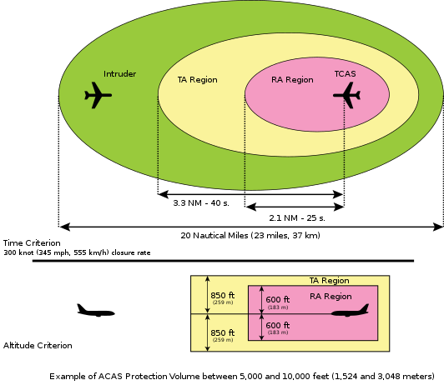
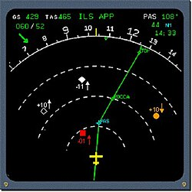
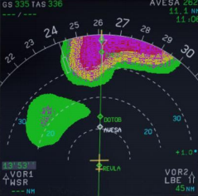
On Board Systems: Data Comms
Aircraft Collision Avoidance System (ACAS/TCAS)
Uses fast IFF Mode3/C and ADSB queries from surrounding aircraft to:
Create a 3D map
Calculate trajectories
Predict collisions
Provide voice alerts.
It is not a radar.
It relies on responses from surrounding aircraft.
Civilian aircraft only have
weather radars:

Slide 20
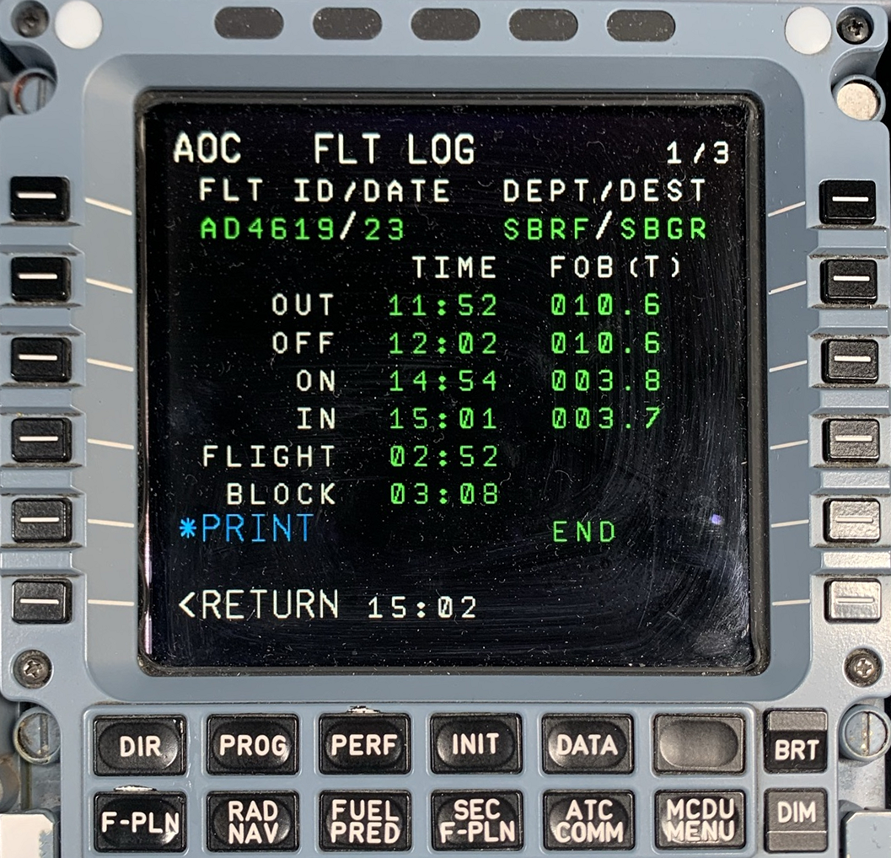
On Board Systems: Data Comms
Aircraft Addressing and Reporting System (ACARS)
= “SMS” for pilots
Uses VHF, HF ή SATCOM data links to send:
Flight phase events (out of gate, weight-off-wheels, weight-on-wheels, in-gate)
Flight plans and weather
Aircraft health status events
Ping & heartbeat
Free text (“SMS”)

Slide 21
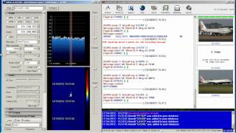
On Board Systems: Data Comms
You can receive ACARS at home with a simple RTL-SDR receiver

Slide 22
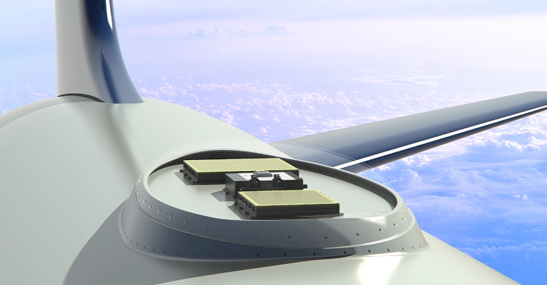
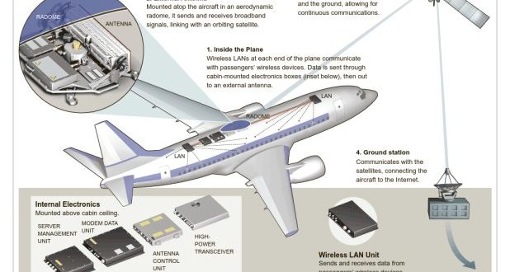
On Board Systems: Data Comms
Satcom
Until recently ~700Kbps with Inmarsat or Iridium,
Now Startlink ~30Mbps (high on board antenna velocity => more difficult satellite tracking and handovers)

Slide 23
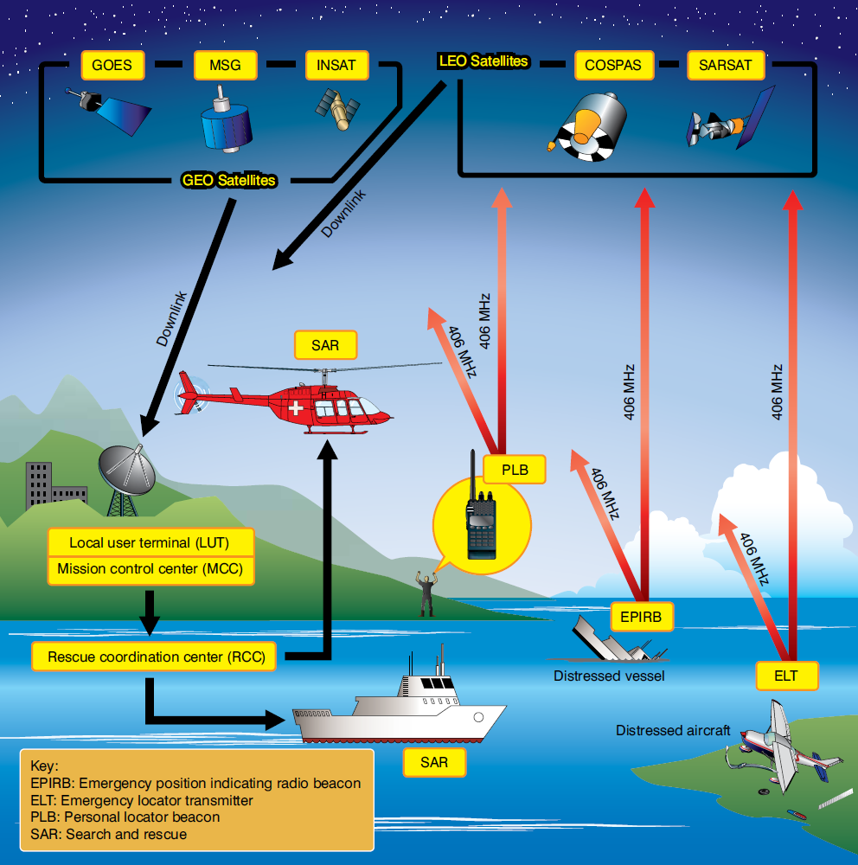
On Board Systems
Εmergency transponders
Automatically activated on
collision
contact with water
They transmit position and ID
To satellites at 406 MHz
To local Search And Rescue at 121.5 MHz
The message is relayed to the country’s Joint Rescue Coordination Centre (JRCC)

Slide 24
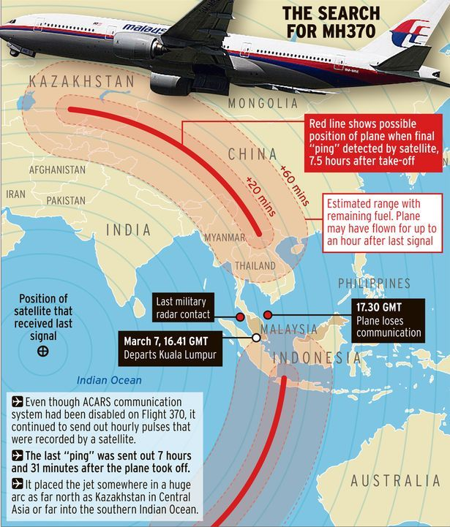
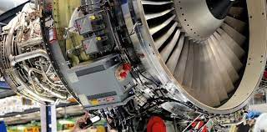
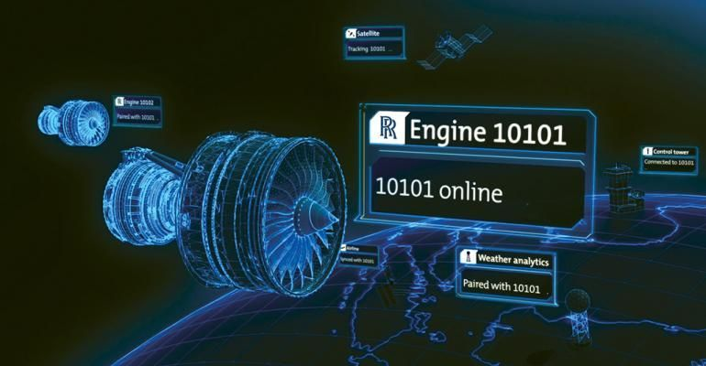
On Board Systems
Engine diagnostics data link
If each of your engines costs 25-45M€, including a built-in global monitoring capability is cheap in comparison.

Slide 25
Demo

Slide 26
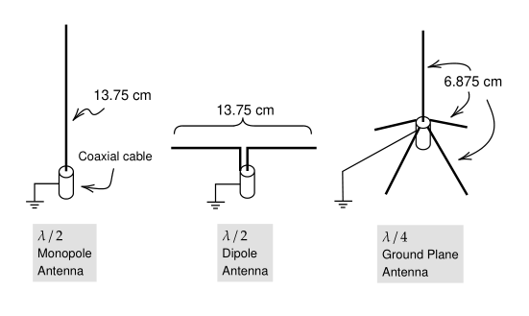
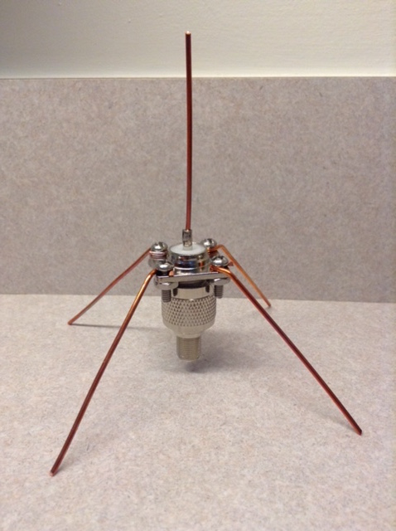
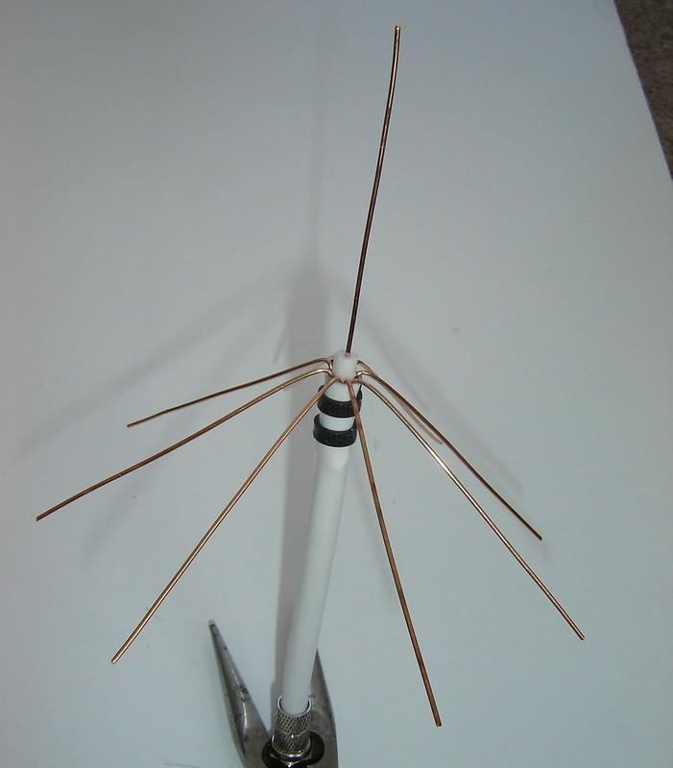
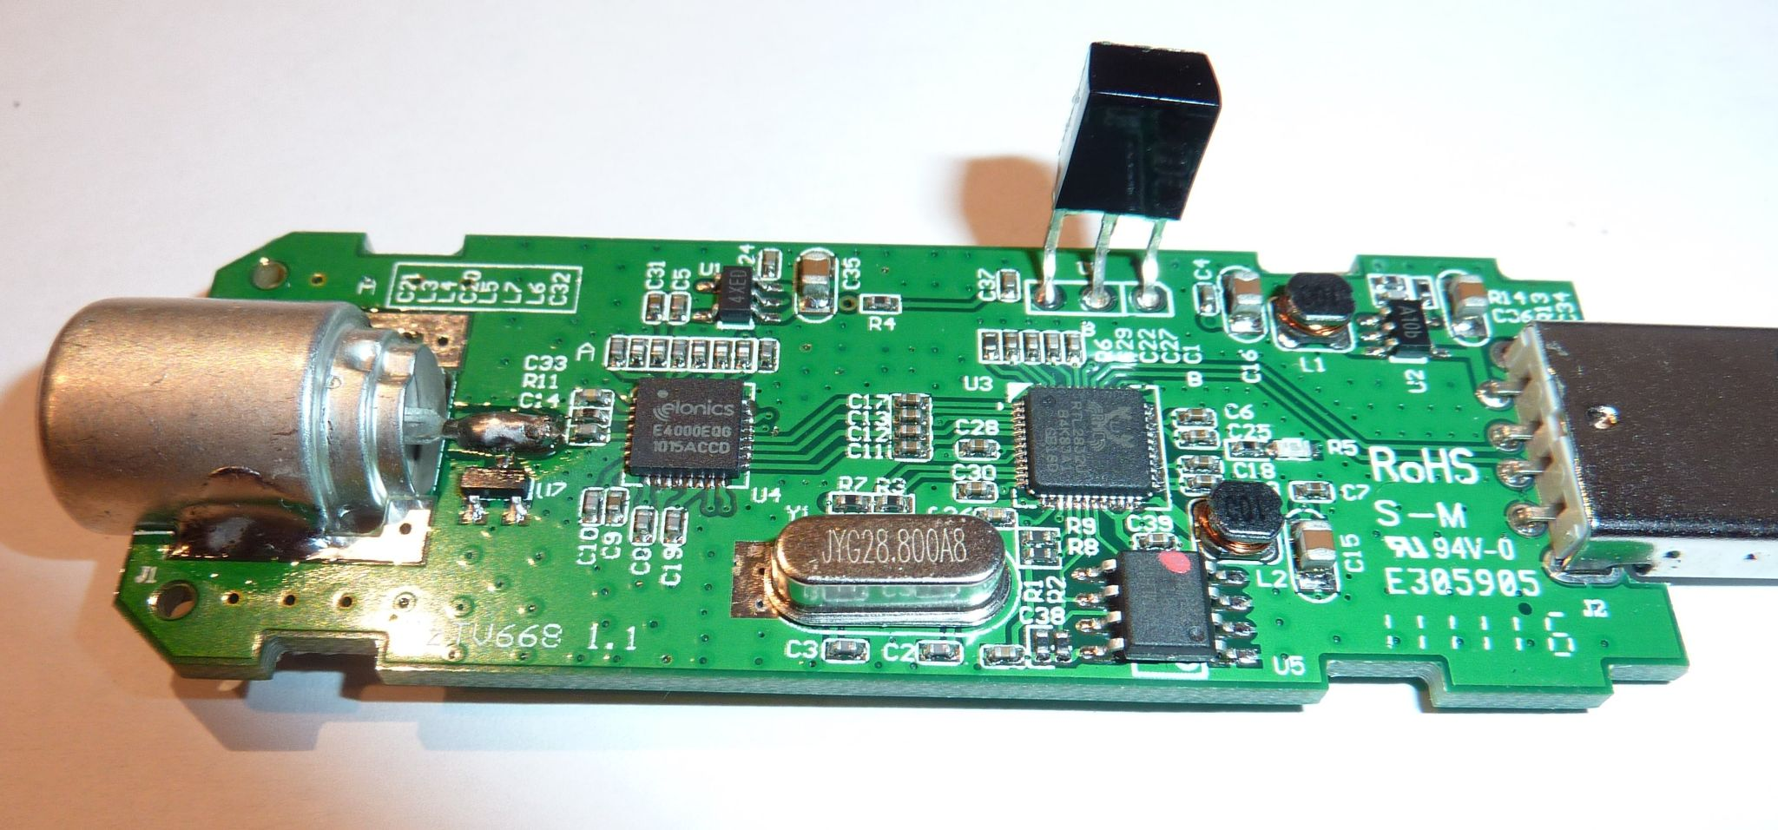
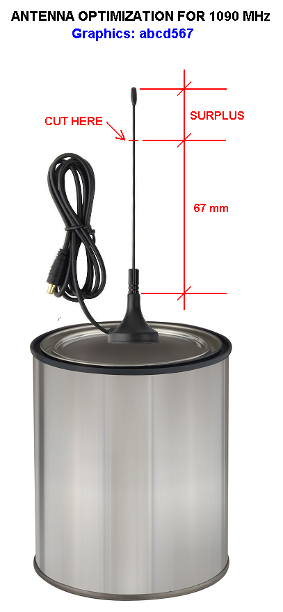
In practice: Running your own ADS-B receiver
Antenna
Receiver
Decoder (dump1090, readsb)
#Pi Zero 2 W #VM #dedicated
Plot map (tar1090)
Share data via network #MLAT
FlightRadar24
AdsbExchange
FlightAware
RadarBox
RDRinfo
etc

Slide 27
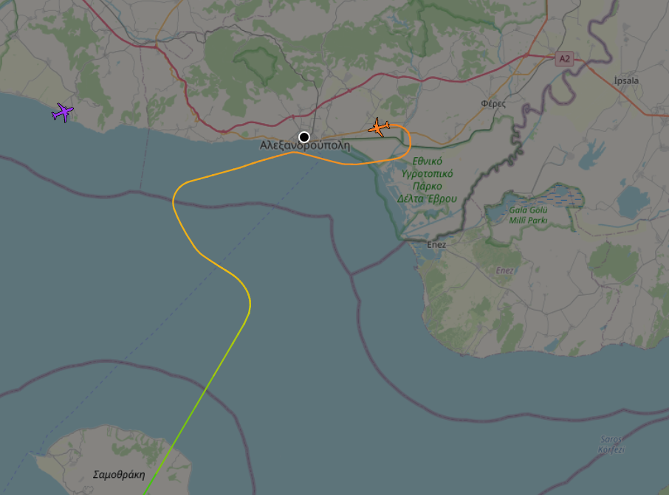
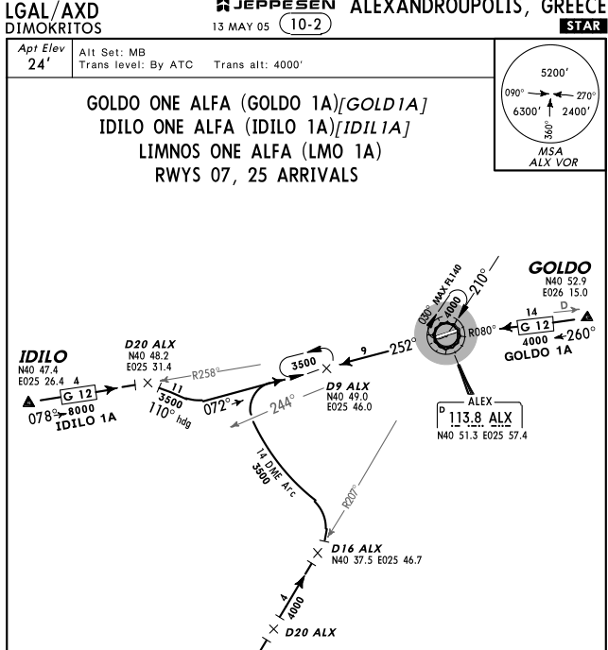
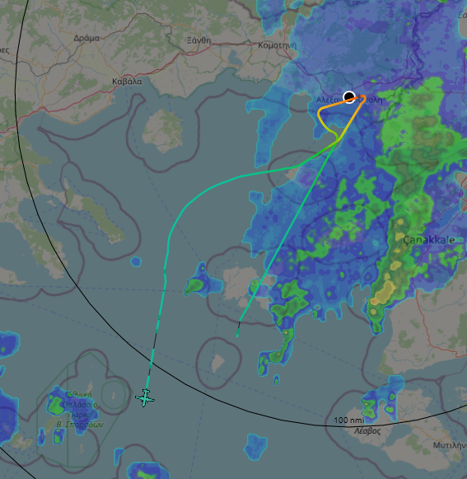
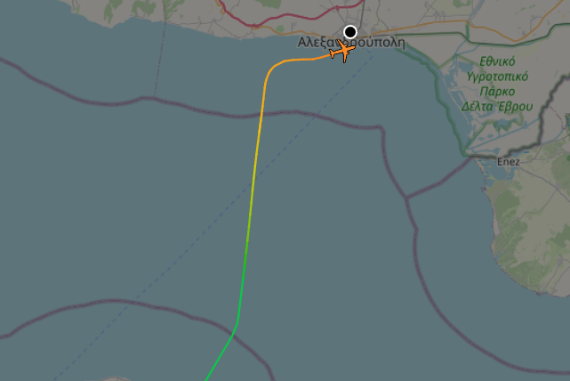
tar1090

Slide 28
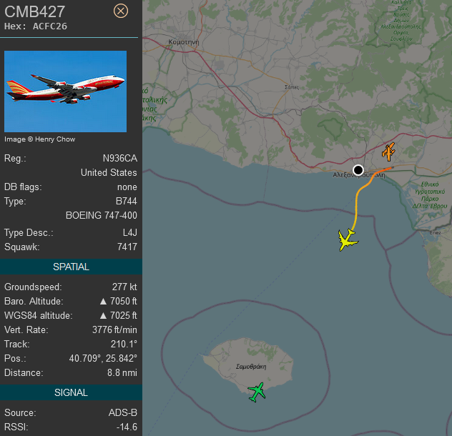
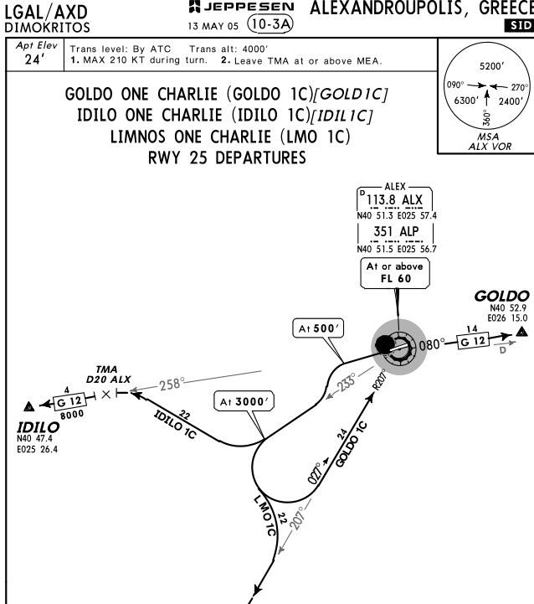
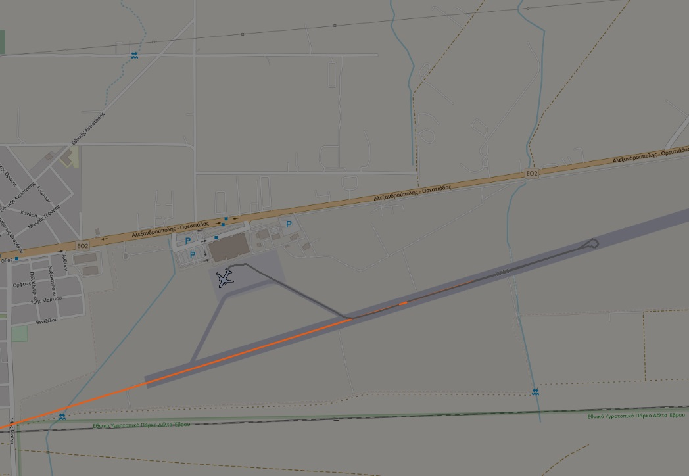
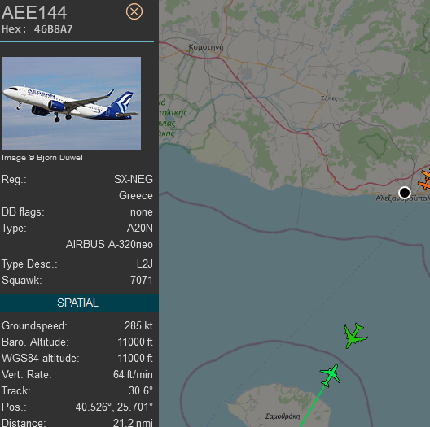
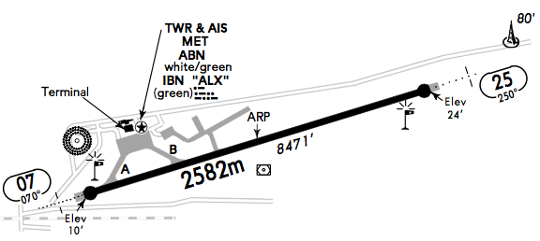
tar1090
Busy time for ATC
2 aircraft holding position
1 departing (standard LMO 1C)
1 approaching

Slide 29
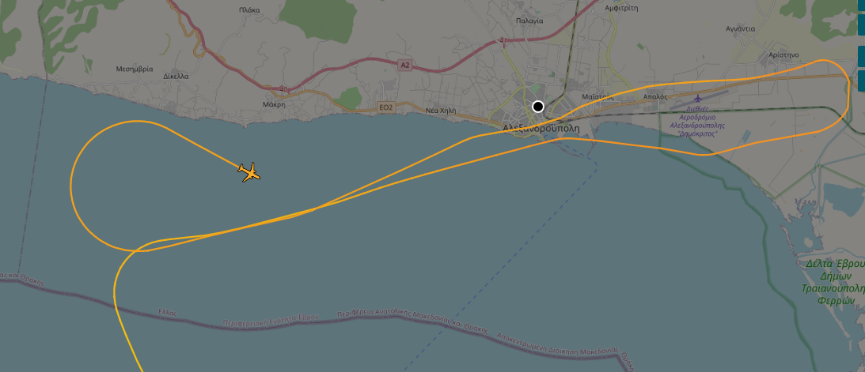
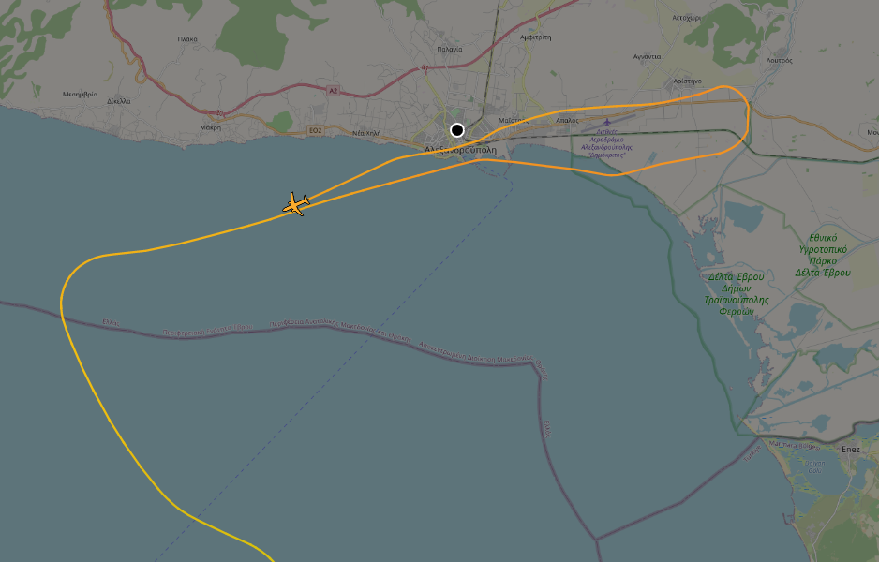
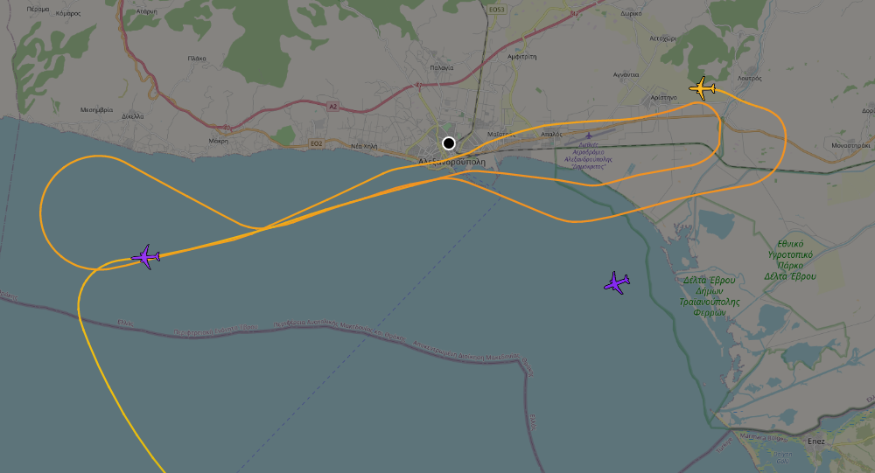
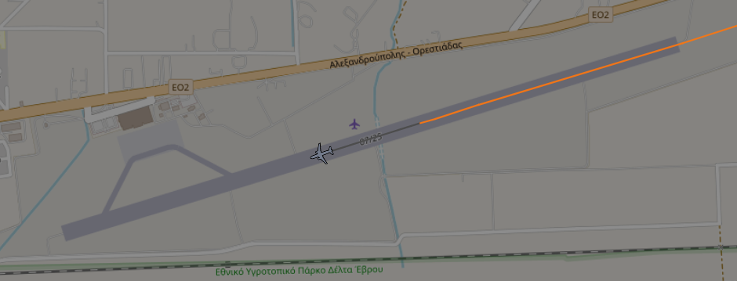
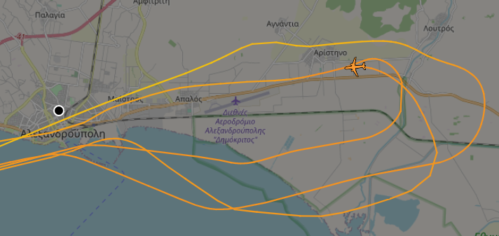
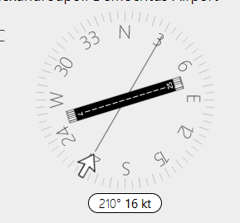
tar1090
METAR LGAL 251920Z
20020G33KT
9999
FEW015TCU SCT025
18/14
Q0982

Slide 30
The Future

Slide 31
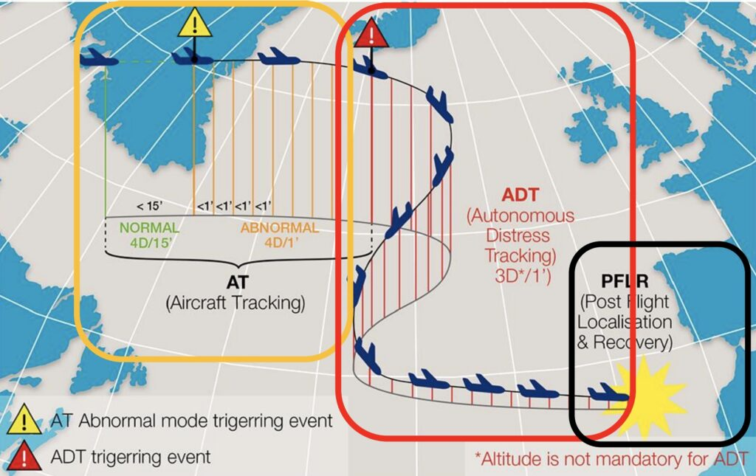
The Future
Distress flight data streaming / black box in the cloud
“so that others can learn”
Continuous FDR/CVR data streaming via satellite for the whole fleet of an airline is unaffordable and requires high bandwidth, even with latest Starlink.
Smart ways are being tested to stream FDR/CVR data via satcom triggered by flight events.
Normal: Sends selective telemetry <20 parameters every 15’.
Abnormal: Starts to send 88 telemetry parameters in dense intervals of 1’.
ADT: On catastrophic failures takes control of the satcom link and starts uploading high volume FDR/CVR data with priority and in reverse chronological order. On average it has 170’ before the crash. The data stream gets priority routing in the space segment and in the ground anchor points.
PFLR: If still functioning, it continues to transmit after the collision / crash landing.

Slide 32
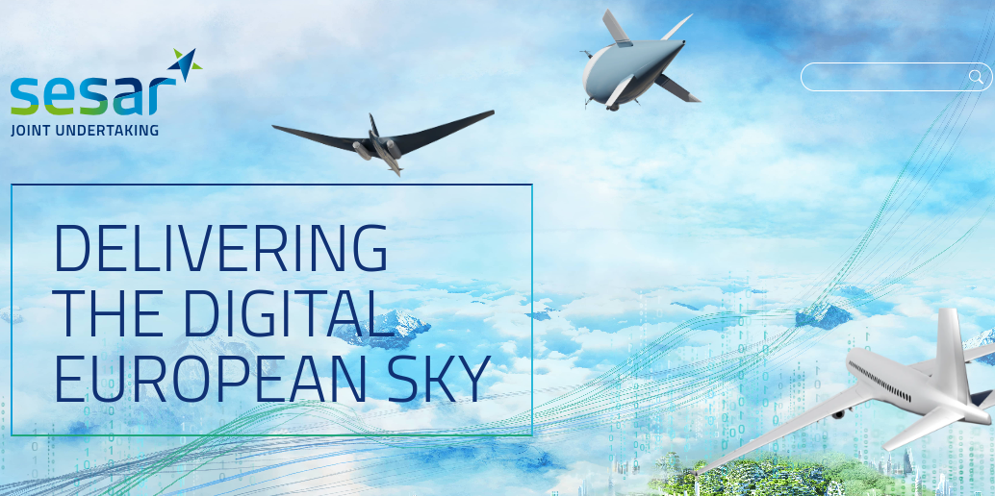
The Future
SESAR (Single European Sky Air Traffic Management Research)
“No air corridors”
Automatic flight routing without corridors (already in 30% of France’s FIR)
Automatic flight separation
Automatic rerouting to avoid weather
Increased capacity and airspace utilization
Mixed airspaces for civilian, military and drones

Slide 33
The Future
Remote Control Towers
Why?
Better visibility (cameras at every runway, transparent buildings via VR)
Efficiency: one controller handles 2-3 small airports
Certified in Europe, pending in the US.
18 airports in Norway started operating with remote control towers since 2022

Slide 34
Extra slides

Slide 35
Quiz
Which is the strongest system in an aircraft … and in your car?
The breaks. All systems are powered by the engine, but the breaks work as a lever.
What colour is an aircraft’s “black box”?
Orange or yellow
How many seconds of delay does a RADAR’s “picture” have?
12 sec, the time it takes the RADAR antenna to do a full rotation.
Can an airplane land automatically?
Yes. On ILS-equipped airports since the 80’s. Still even today, pilots do take-offs and landings and the autopilot does 90% of the flight.
What do the numbers at the end of the runway mean?
The runway’s azimuth (its angle with respect to the north)
Does a RADAR affect snowfall in its area?
No. Its power is in the KWatts range. Its energy dissipates fast due to the inverse square law. It still can light up an incandescent light bulb 50-100 m away.
What are the most common causes of air accidents?
50% pilot error, 20% malfunction, 10% weather, 10% sabotage, 10% air-traffic control etc.
What are aircraft’s tyres filled with?
Nitrogen. So that they don’t ignite if they burst.
What’s an airline’s highest financial value asset?
The “miles” in its loyalty programme (miles & bonus etc). Not even its expensive aircraft.
What’s the typical profit margin of an airline?
Less than 9%
How much more than the co-pilot does an airline captain earn?
2 to 4 times more.

Slide 36
Questions?

Slide 37
Tar1090 - extra time
missed approach
Busy time on LGAL

Slide 38
FR24 3D view

Slide 39
LGAL tower

Slide 40
LGAL ARP

Slide 41
GR slides

Slide 42
Quiz
Ποιό είναι το πιο δυνατό σύστημα σ’ ένα αεροσκάφος… και στο αυτοκίνητό σας;
Τα φρένα. Όλα τα συστήματα παίρνουν ενέργεια απ’ τους κινητήρες, αλλά τα φρένα λειτουργούν σαν μοχλός.
Τι χρώμα είναι το “μαύρο κουτί” ενός αεροσκάφους;
Πορτοκαλί/κίτρινο
Πόσα δευτερόλεπτα υστέρηση έχει η εικόνα του radar;
12sec, όσο μια πλήρης περιστροφή της κεραίας του radar.
Μπορεί ένα αεροπλάνο να προσγειωθεί αυτόματα;
Ναι. Σ’ αεροδρόμια με ILS, απ’ τα 80s. Ωστόσο ακόμα και σήμερα οι πιλότοι απογειώνουν και προσγειώνουν κ το 90% της πτήσης γίνεται μ’ autopilot.
Τι σημαίνουν οι αριθμοί στην άκρη του διαδρόμου προσγείωσης;
Το αζιμούθιο του (= η γωνία σε σχέση με το βορρά)
Επηρεάζει ένα ραντάρ τη χιονόπτωση στην περιοχή του;
Όχι. Η ενέργεια είναι λίγα KW και φθίνει γρήγορα λόγω inverse square law. Μπορεί όμως ν’ ανάψει μια λάμπα φθορισμού στα 50-100μ
Ποιά είναι η πιο συχνή αιτία αεροπορικών ατυχημάτων;
50% pilot error, 20% τεχνική βλάβη, 10% κακοκαιρία, 10% sabotage, 10% air-traffic control etc
Με τι είναι γεμάτα τα λάστιχα ενός αεροπλάνου;
Αζωτο. Για να μην αναφλεγεί αν σκάσουν.
Ποιό είναι το asset μεγαλύτερης αξίας μια αεροπορικής εταιρείας;
Τα μίλια του προγραμματος loyalty της (miles & bonus etc). Ούτε καν τα ίδια τα πανάκριβα αεροπλάνα της.
Με τι περιθώριο κέρδους λειτουργεί μια αεροπορική εταιρεία;
Συνήθως μικρότερο από 9%

Slide 43
IFF (Identification Friend or Foe)
Το αφος απαντάει σε κωδικοποιημένες ερωτήσεις που του στέλνει στα 1030/1090MHz κάποιος σταθμός εδάφους ή άλλο αφος.
= Το “ping” των αεροπλάνων.
Συνήθως το μήνυμα περιλαμβάνει
Mode 3 (4ψήφιο ID που θέτει το πλήρωμα) και
Mode C (ύψος πτήσης)
Μπορεί να περιέχουν λάθος/παραπλανητικές πληροφορίες.
IFF emergency codes:
7500 Αεροπειρατεία
7600 Απώλεια επικοινωνιών
7700 Κατάσταση ανάγκης γενικά (βλάβη κλπ)
Notes:
Σε μια τυπική μέρα έχεις 2-3 7700 squawk codes πάνω απ’ την Ευρώπη.

Slide 44
Τι είναι και τι σκοπό έχει
Air Traffic Control ή Έλεγχος Εναέριας Κυκλοφορίας είναι μια υπηρεσία η οποία παρέχεται από ελεγκτές στο έδαφος οι οποίοι καθοδηγούν τα αεροσκάφη σε ελεγχόμενο εναέριο χώρο και παρέχουν πληροφορίες και υποστήριξη σε αεροσκάφη που πετούν σε μη ελεγχόμενο εναέριο χώρο. Σκοπός του Ελέγχου Εναέριας Κυκλοφορίας είναι η πραγματοποίηση των πτήσεων με ασφάλεια, τάξη και αποτελεσματικότητα.

Slide 45
On Board Systems: Voice Comms
Μετά πρέπει να μπορεί να στείλει τη θέση του στο ATCC και σ’ άλλα αεροσκάφη φωνητικά ή μέσω data links.
2 ολόιδια, εναλλάξιμα voice radios ACTIVE + STANDBY
VHF/UHF radios: “Air band”. Απαγορεύεται να εκπέμψουν άλλοι.
Civilian: VHF 108-137 MHz , Guard 121.5MHz
Military: +UHF 225-399 MHz, Guard 243MHz
ICAO rules: πάντα ακούν όλοι και στη guard.
ΑΜ modulation γιατί:
Ειναι πιο απλοί κ power efficient πομποδέκτες
Συμβατοί με παλαιότερες τεχνολογίες
Αλλά κυρίως γιατί αν εκπέμψουν 2 ταυτόχρονα θ’ ακουστεί ο πιο δυνατός. Στα FM δε θ’ ακουγόταν κανείς.
Μικρή ισχύς εκπομπής (25W) αλλά πιάνουν καλά γιατί είναι πολύ ψηλά:
απο 20m ύψος (ταράτσα πολυκατοικίας) έχεις 18Km line of sight
απο 10Km ύψος πτήσης έχεις 400Km line of sight. Στην πράξη 200Km => 120.000Km² επιφάνεια = Ελλάδα

Slide 46
Quiz
Ποιό είναι το πιο δυνατό σύστημα σ’ ένα αεροσκάφος… και στο αυτοκίνητό σας;
Τα φρένα. Όλα τα συστήματα παίρνουν ενέργεια απ’ τους κινητήρες, αλλά τα φρένα λειτουργούν σαν μοχλός.
Τι χρώμα είναι το “μαύρο κουτί” ενός αεροσκάφους;
Πορτοκαλί/κίτρινο
Πόσα δευτερόλεπτα υστέρηση έχει η εικόνα του radar;
12sec, όσο μια πλήρης περιστροφή της κεραίας του radar.
Μπορεί ένα αεροπλάνο να προσγειωθεί αυτόματα;
Ναι. Σ’ αεροδρόμια με ILS, απ’ τα 80s. Ωστόσο ακόμα και σήμερα οι πιλότοι απογειώνουν και προσγειώνουν κ το 90% της πτήσης γίνεται μ’ autopilot.
Τι σημαίνουν οι αριθμοί στην άκρη του διαδρόμου προσγείωσης;
Το αζιμούθιο του (= η γωνία σε σχέση με το βορρά)
Επηρεάζει ένα ραντάρ τη χιονόπτωση στην περιοχή του;
Όχι. Η ενέργεια είναι λίγα KW και φθίνει γρήγορα λόγω inverse square law. Μπορεί όμως ν’ ανάψει μια λάμπα φθορισμού στα 50-100μ
Ποιά είναι η πιο συχνή αιτία αεροπορικών ατυχημάτων;
50% pilot error, 20% τεχνική βλάβη, 10% κακοκαιρία, 10% sabotage, 10% air-traffic control etc
Με τι είναι γεμάτα τα λάστιχα ενός αεροπλάνου;
Αζωτο. Για να μην αναφλεγεί αν σκάσουν.
Ποιό είναι το asset μεγαλύτερης αξίας μια αεροπορικής εταιρείας;
Τα μίλια του προγραμματος loyalty της (miles & bonus etc). Ούτε καν τα ίδια τα πανάκριβα αεροπλάνα της.
Με τι περιθώριο κέρδους λειτουργεί μια αεροπορική εταιρεία;
Συνήθως μικρότερο από 9%

Slide 47
Για τι θα μιλήσουμε
Τι είναι το ATC και τι σκοπό έχει
Civilian vs military
Flight phases - Handovers Between Controllers
Ground Systems
Sensor types
Cooperative (IFF modes, ADSB)
Non-cooperative: active radar
Passive: MLAT https://map.adsbexchange.com/mlat-map/
Sensor to Controller data flow (track creation) From plot to track
Protocols (asterix, beast, radarcape, military protocols)
On-board systems
Πως ξέρει τη θέση του στο χώρο ένα αεροσκάφος; (INS, GPS, NDB/VOR, ILS, LORAN, Radio altimeter)
Πως επικοινωνεί voice & data ένα αεροσκάφος (V/UHF radios, IFF, satcom, emergency transponders)
Demo:
ADS-B
MLAT?
Το μέλλον
SESAR “bye-bye corridors”
black box in the cloud
remote control towers

